Slide 1



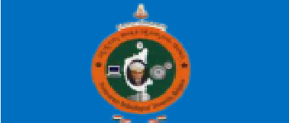


Bangalore Institute of Technology
K.R. Road, V.V. Pura, Bengaluru.-560004.
Department of Computer Science & Engineering
Internship Presentation on Credit Card Fraud Detection
By:
Kushal S Gowda(1BI20AI024)
Under the Guidance of
Prof. Manjunath
Assistant Professor Dept. of CSE

Slide 2
ABSTRACT
Credit card fraud has become a significant concern in the modern financial landscape, leading to substantial financial losses for both financial institutions and cardholders. To combat this problem, machine learning techniques have emerged as a powerful tool for detecting fraudulent transactions efficiently and effectively. This project focuses on the development of a credit card fraud detection system using machine learning algorithms.
The objective of this project is to design and implement a robust fraud detection model capable of identifying potentially fraudulent transactions in real-time.

Slide 3
CONTENTS
Introduction
Problem Statement
Objective
Dataset
Libraries Used
Implementation
Outcome of the project
Conclusion

Slide 4
INTRODUCTION
In an increasingly digital and interconnected financial landscape, the security of credit card transactions is paramount. The Credit Card Fraud Detection project addresses this critical concern by harnessing the power of machine learning and data analytics. This project aims to develop a robust system that can effectively identify and prevent fraudulent credit card transactions. By leveraging historical data, feature engineering, and real-time monitoring, this system enhances the security of financial transactions, safeguarding both cardholders and financial institutions from unauthorized or deceitful activities.

Slide 5
PROBLEM STATEMENT
The prevalence of credit card fraud poses a substantial financial threat to both financial institutions and cardholders. In recent years, the rise of online transactions and digital payment methods has exacerbated this issue, making it imperative to develop advanced fraud detection systems. The primary challenge is to create a robust and efficient credit card fraud detection system using machine learning techniques.

Slide 6
OBJECTIVES
• Develop an accurate machine learning model for credit card fraud detection.
Implement a real-time fraud detection system that operates seamlessly during transactions.
Optimize the model's performance through hyperparameter tuning and fine-tuning.
Establish mechanisms for continuous learning and adaptation to evolving fraud patterns.

Slide 7
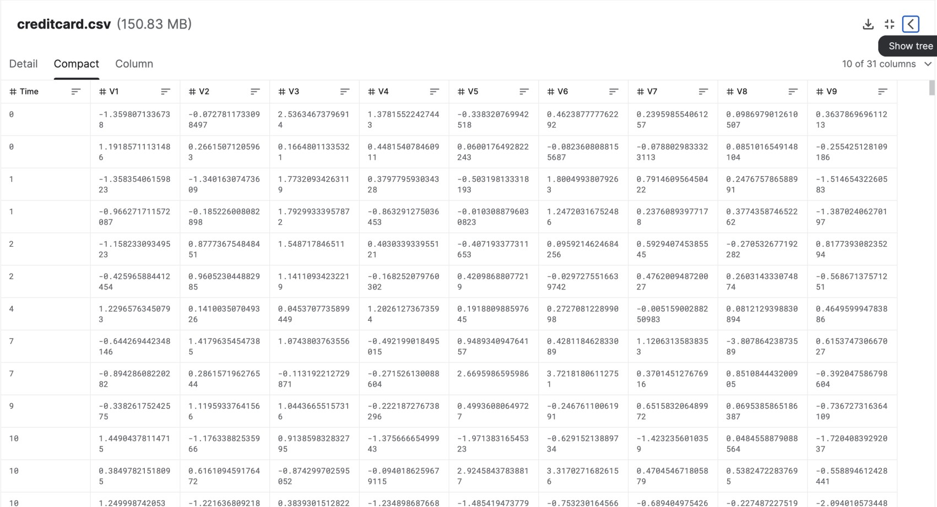
DATASET

Slide 8
LIBRARIES USED
Numpy (For numerical analysis)
Pandas (For handling data files)
Matplotlib
Seaborn

Slide 9
IMPLEMENTATION
1. Classification Model # importing necessary libraries import matplotlib.pyplot as plt # EDA for analyzing the data
# dropping unnecessary columns data.drop(['Unnamed:
0','img_link'],axis=1,inplace=True) data.fillna(0, inplace=True) data.info()
df = pd.read_csv('creditcard.csv') df.head()
df.info()
df.describe()save_model(forest,'Random Forest Model') saved_forest=load_model('Random Forest Model')

Slide 10
saved_model_prediction=predict_model(saved_forest,data=test_data) saved_model_prediction.head(8)
df.isnull().sum()
fraud = round(len(df[df['Class']==1])/len(df)*100,2) nofraud = round(len(df[df['Class']==0])/len(df)*100,2)
print("No fraud transactions are:",str(nofraud)+'%',"of the dataset") print("Fraud transactions are:",str(fraud)+'%',"of the dataset")
#price range plt.figure(figsize=(12,6))
sns.histplot(data = data, x = 'price(in Rs.)', kde =
True,bins=20) plt.title('Price Range of the Laptops') plt.show()

Slide 12
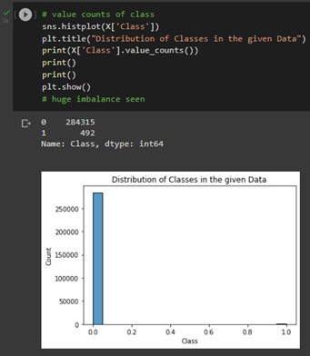

Slide 13
Comfusion Matrix
from sklearn.metrics import confusion_matrix y_pred_log_reg = log_reg.predict(X_test) y_pred_knear = knears_neighbors.predict(X_test) y_pred_svc = svc.predict(X_test)
y_pred_tree = tree_clf.predict(X_test)
log_reg_cf = confusion_matrix(y_test, y_pred_log_reg) kneighbors_cf = confusion_matrix(y_test, y_pred_knear) svc_cf = confusion_matrix(y_test, y_pred_svc)
tree_cf = confusion_matrix(y_test, y_pred_tree)
fig, ax = plt.subplots(2, 2,figsize=(22,12))
sns.heatmap(log_reg_cf, ax=ax[0][0], annot=True)

Slide 14
ax[0, 0].set_title("Logistic Regression \n Confusion Matrix", fontsize=14)
ax[0, 0].set_xticklabels(['', ''], fontsize=14, rotation=90) ax[0, 0].set_yticklabels(['', ''], fontsize=14, rotation=360)
sns.heatmap(kneighbors_cf, ax=ax[0][1], annot=True) ax[0][1].set_title("KNearsNeighbors \n Confusion Matrix", fontsize=14) ax[0][1].set_xticklabels(['', ''], fontsize=14, rotation=90) ax[0][1].set_yticklabels(['', ''], fontsize=14, rotation=360)
sns.heatmap(svc_cf, ax=ax[1][0], annot=True) ax[1][0].set_title("Suppor Vector Classifier \n Confusion Matrix", fontsize=14)
ax[1][0].set_xticklabels(['', ''], fontsize=14, rotation=90) ax[1][0].set_yticklabels(['', ''], fontsize=14, rotation=360)
sns.heatmap(tree_cf, ax=ax[1][1], annot=True)

Slide 15
ax[1][1].set_title("DecisionTree Classifier \n Confusion Matrix", fontsize=14)
ax[1][1].set_xticklabels(['', ''], fontsize=14, rotation=90) ax[1][1].set_yticklabels(['', ''], fontsize=14, rotation=360)

Slide 16
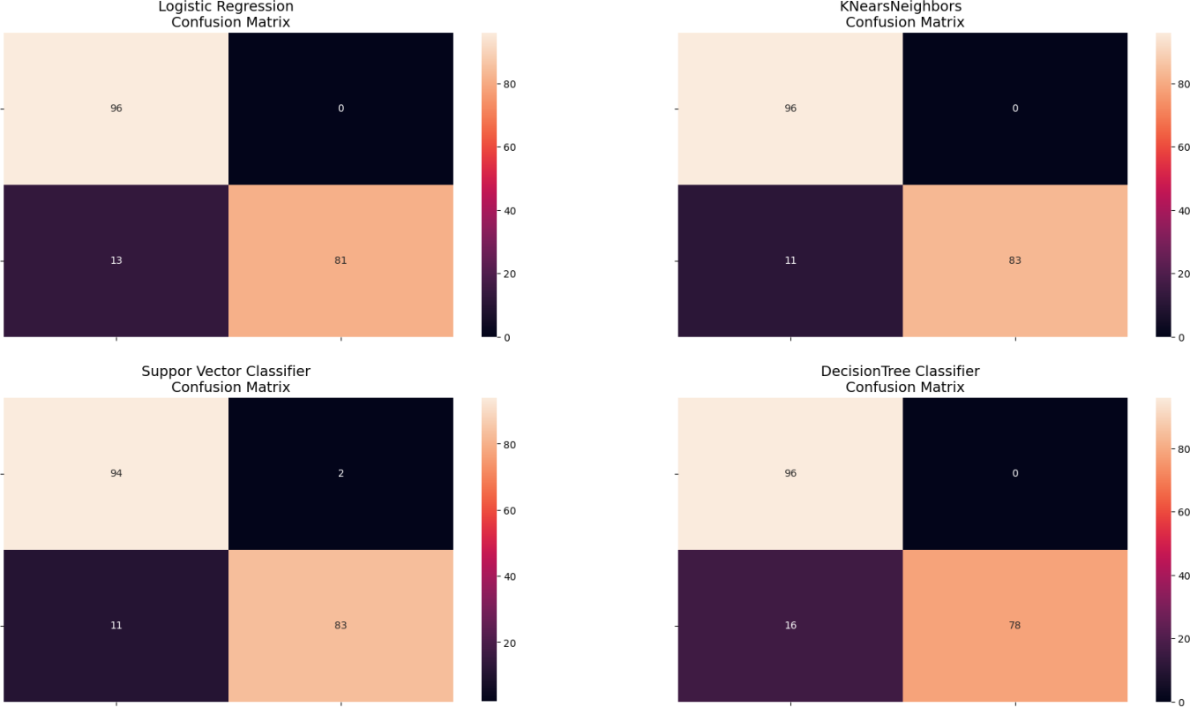

Slide 17
2. Regression Model corr = df.corr() sns.heatmap(corr, cmap='coolwarm_r', annot_kws={'size':20}, ax=ax1) ax1.set_title("Imbalanced Correlation Matrix \n (don't use for reference)", fontsize=14)
# new_df sub_sample_corr = new_df.corr() sns.heatmap(sub_sample_ corr, cmap='coolwarm_r',

Slide 18
annot_kws={'size':20}, ax=ax2) ax2.set_title('SubSample Correlation Matrix \n (use for reference)', fontsize=14

Slide 19
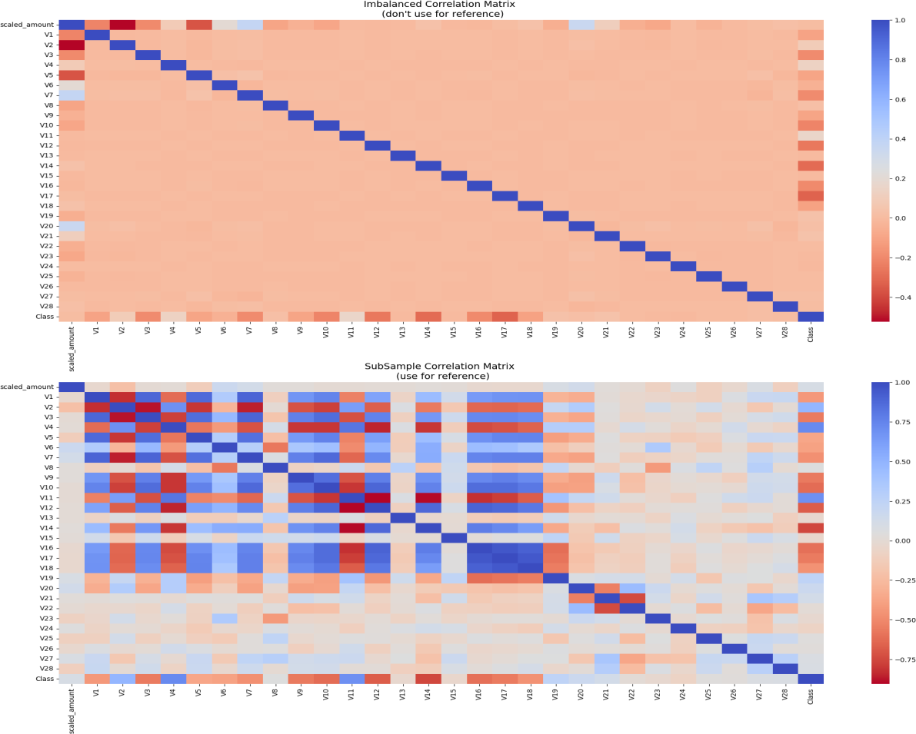

Slide 20
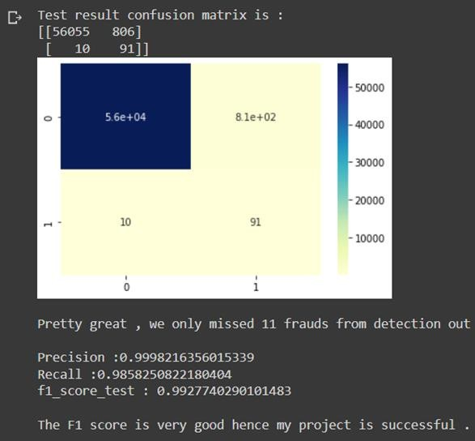

Slide 21
Visualisation
from sklearn.manifold import TSNE
from sklearn.decomposition import PCA, TruncatedSVD import matplotlib.patches as mpatches
import time
X = new_df.drop('Class',axis=1) y = new_df['Class']
#TSNE implementation t0 = time.time()
X_reduced_tsne = TSNE(n_components=2,
random_state=42).fit_transform(X.values) line ####
t1 = time.time()
print("T-SNE took {:.2} s".format(t1-t0)) #PCA implementation
t0 = time.time()
X_reduced_pca = PCA(n_components=2, random_state=42).fit_transform(X.values) this line ####
#### Complete this
#### Complete

Slide 22
t1 = time.time()
print("PCA took {:.2} s".format(t1-t0)) #TruncatedSVD implementation
t0 = time.time()
X_reduced_svd = TruncatedSVD(n_components=2, random_state=42).fit_transform(X.values)
t1 = time.time()
print("Truncated SVD took {:.2} s".format(t1-t0)) f, (ax1,ax2,ax3) = plt.subplots(1,3,figsize=(24,6))
f.suptitle('Clusters after dimensionality reducation',fontsize=14)
blue_patch = mpatches.Patch(color='blue',label = 'No fraud') red_patch = mpatches.Patch(color='red',label='Fraud')
# t-SNE scatter plot
ax1.scatter(X_reduced_tsne[:,0], X_reduced_tsne[:,1], c=(y == 0), cmap='coolwarm', label='No Fraud', linewidths=2) ax1.scatter(X_reduced_tsne[:,0], X_reduced_tsne[:,1], c=(y == 1), cmap='coolwarm', label='Fraud', linewidths=2)

Slide 23
ax1.set_title('t-SNE', fontsize=14) ax1.grid(True) ax1.legend(handles=[blue_patch, red_patch])
ax2.scatter(X_reduced_pca[:,0], X_reduced_pca[:,1], c=(y == 0),
cmap='coolwarm', label='No Fraud', linewidths=2) ax2.scatter(X_reduced_pca[:,0], X_reduced_pca[:,1], c=(y == 1), cmap='coolwarm', label='Fraud', linewidths=2) ax2.set_title('PCA', fontsize=14) ax2.legend(handles=[blue_patch, red_patch])
# TruncatedSVD scatter plot
ax3.scatter(X_reduced_svd[:,0], X_reduced_svd[:,1], c=(y == 0), cmap='coolwarm', label='No Fraud', linewidths=2) ax3.scatter(X_reduced_svd[:,0], X_reduced_svd[:,1], c=(y == 1), cmap='coolwarm', label='Fraud', linewidths=2) ax3.set_title('Truncated SVD', fontsize=14)
ax3.grid(True) ax3.legend(handles=[blue_patch, red_patch])

Slide 24
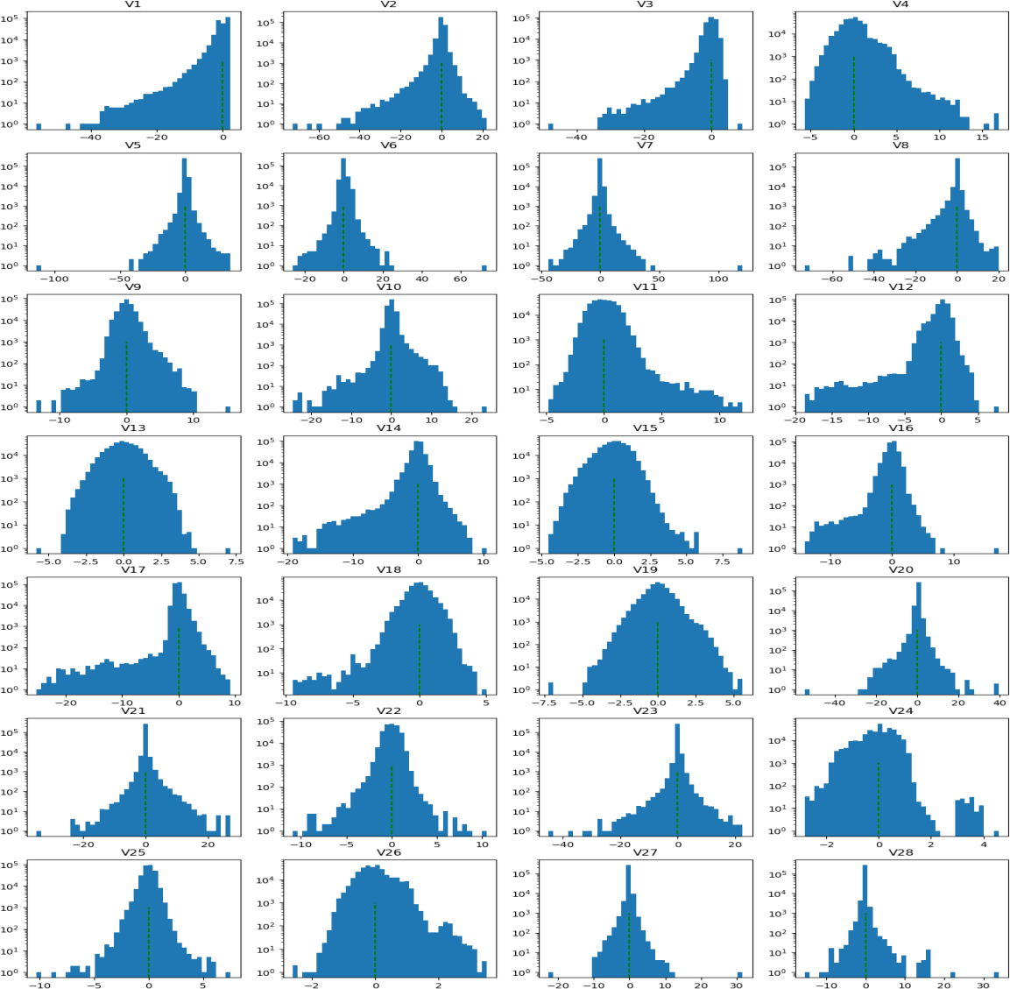

Slide 25
CONCLUSION
In conclusion, the Credit Card Fraud Detection project has successfully developed and implemented a robust machine learning-based system capable of accurately identifying and preventing fraudulent transactions. Through data analysis, feature engineering, and the utilization of various machine learning algorithms, this system provides real-time protection to both cardholders and financial institutions. With continuous monitoring and adaptation to evolving fraud patterns, it serves as a vital safeguard against financial losses and reinforces the security of modern financial transactions. The project underscores the importance of leveraging advanced analytics and automation in addressing the ongoing challenge.

Slide 26
THANK YOU

